Slide 1
SSI CSI Local Survey Satisfaction Score June 2020
PT Nissan Motor Indonesia
Customer Quality

Slide 2
CSI & SSI NATIONAL

Slide 3
SSI CSI by Area – May 2020
NATIONAL
SSI | 940
CSI | 887
SSI Target : | 930
CSI Target : | 880
SUMATERA | RESULT |  | RANK
SSI | 967 |  | 4
CSI | 892 |  | 3
RMMG
SSI | 988
CSI | 866
KALIMANTAN | RESULT |  | RANK
SSI | 0 |  | 8
CSI | 874 |  | 8
JKMG
SSI | 0
CSI | 871
SULAWESI | RESULT |  | RANK
SSI | 980 |  | 3
CSI | 876 |  | 7
IMG
SSI | 935
CSI | 882
CENTRAL JAVA | RESULT |  | RANK
SSI | 999 |  | 1
CSI | 897 |  | 2
WSBYG
SSI | 1,000
CSI | 928
WEST JAVA | RESULT |  | RANK
SSI | 986 |  | 2
CSI | 902 |  | 1
BALI LOMBOK | RESULT |  | RANK
SSI | 0 |  | 7
CSI | 883 |  | 5
DPOG
SSI | 0
CSI | 0
JABODETABEK |  | RESULT |  | RANK
SSI |  | 918 |  | 5
CSI |  | 887 |  | 4
JABO 1 | SSI | 926
 | CSI | 891
JABO 2 | SSI | 902
 | CSI | 884
EAST JAVA | RESULT |  | RANK
SSI | 863 |  | 6
CSI | 878 |  | 6
MPAG
SSI | 937
CSI | 935
 | SSI and CSI Index Region >= Target
 | SSI or CSI Index Region < Target
 | SSI and CSI Index Region < Target
AKAG
SSI | 930
CSI | 900
 | Index Score > previous month
 | Index Score < previous month
 | Index Score = previous month
MUAG
SSI | 0
CSI | 0

Slide 4
SSI CSI by Area – June 2020
NATIONAL
SSI | 946
CSI | 877
SSI Target : | 930
CSI Target : | 880
SUMATERA | RESULT |  | RANK
SSI | 935 |  | 7
CSI | 887 |  | 2
RMMG
SSI | 0
CSI | 903
KALIMANTAN | RESULT |  | RANK
SSI | 857 |  | 8
CSI | 862 |  | 8
JKMG
SSI | 976
CSI | 883
SULAWESI | RESULT |  | RANK
SSI | 979 |  | 2
CSI | 866 |  | 7
IMG
SSI | 946
CSI | 874
CENTRAL JAVA | RESULT |  | RANK
SSI | 953 |  | 3
CSI | 882 |  | 3
WSBYG
SSI | 955
CSI | 903
WEST JAVA | RESULT |  | RANK
SSI | 984 |  | 1
CSI | 899 |  | 1
BALI LOMBOK | RESULT |  | RANK
SSI | 947 |  | 6
CSI | 874 |  | 5
DPOG
SSI | 816
CSI | 906
JABODETABEK |  | RESULT |  | RANK
SSI |  | 949 |  | 5
CSI |  | 872 |  | 6
JABO 1 | SSI | 949
 | CSI | 869
JABO 2 | SSI | 948
 | CSI | 874
EAST JAVA | RESULT |  | RANK
SSI | 953 |  | 4
CSI | 878 |  | 4
MPAG
SSI | 954
CSI | 893
 | SSI and CSI Index Region >= Target
 | SSI or CSI Index Region < Target
 | SSI and CSI Index Region < Target
AKAG
SSI | 988
CSI | 855
 | Index Score > previous month
 | Index Score < previous month
 | Index Score = previous month
MUAG
SSI | 812
CSI | 870

Slide 5
SSI CSI by Area – June 2020 – CSA (1/3)
NATIONAL
SSI | 946
CSI | 877
SSI Target : | 930
CSI Target : | 880
JABODETABEK
CSA #1 | RESULT |  | RANK
SSI | 927 |  | 21
CSI | 882 |  | 14
CSA #2 | RESULT |  | RANK
SSI | 0 |  | 33
CSI | 794 |  | 43
CSA #3 | RESULT |  | RANK
SSI | 998 |  | 2
CSI | 868 |  | 23
CSA #4 | RESULT |  | RANK
SSI | 952 |  | 18
CSI | 874 |  | 18
CSA #5 | RESULT |  | RANK
SSI | 991 |  | 4
CSI | 867 |  | 24
CSA #6 | RESULT |  | RANK
SSI | 923 |  | 22
CSI | 834 |  | 40
CSA #8 | RESULT |  | RANK
SSI | 928 |  | 20
CSI | 859 |  | 30
CSA #9 | RESULT |  | RANK
SSI | 0 |  | 34
CSI | 823 |  | 42
CSA #10 | RESULT |  | RANK
SSI | 961 |  | 13
CSI | 862 |  | 26
WEST JAVA
CSA #17 | RESULT |  | RANK
SSI | 979 |  | 10
CSI | 868 |  | 22
CSA #18 | RESULT |  | RANK
SSI | 0 |  | 35
CSI | 878 |  | 16
CSA #19 | RESULT |  | RANK
SSI | 980 |  | 9
CSI | 910 |  | 4
CSA #20 | RESULT |  | RANK
SSI | 0 |  | 36
CSI | 941 |  | 2
CSA #21 | RESULT |  | RANK
SSI | 0 |  | 37
CSI | 835 |  | 39
CSA #22 | RESULT |  | RANK
SSI | 998 |  | 1
CSI | 899 |  | 8
CSA #11 | RESULT |  | RANK
SSI | 983 |  | 8
CSI | 887 |  | 11
CSA #12 | RESULT |  | RANK
SSI | 919 |  | 23
CSI | 855 |  | 33
CSA #13 | RESULT |  | RANK
SSI | 988 |  | 6
CSI | 855 |  | 34
CSA #15 | RESULT |  | RANK
SSI | 954 |  | 15
CSI | 870 |  | 20
CSA #16 | RESULT |  | RANK
SSI | 816 |  | 30
CSI | 906 |  | 5
 | SSI and CSI Index Region >= Target
 | SSI or CSI Index Region < Target
 | SSI and CSI Index Region < Target
 | Index Score > previous month
 | Index Score < previous month
 | Index Score = previous month

Slide 6
SSI CSI by Area – May 2020 – CSA (2/3)
NATIONAL
SSI | 946
CSI | 877
SSI Target : | 930
CSI Target : | 880
SUMATERA
CSA #41 | RESULT |  | RANK
SSI | 0 |  | 42
CSI | 943 |  | 1
CSA #42 | RESULT |  | RANK
SSI | 974 |  | 12
CSI | 896 |  | 9
CSA #43 | RESULT |  | RANK
SSI | 951 |  | 19
CSI | 861 |  | 28
CSA #44 | RESULT |  | RANK
SSI | 0 |  | 43
CSI | 903 |  | 7
CSA #45 | RESULT |  | RANK
SSI | 847 |  | 29
CSI | 885 |  | 12
CSA #46 | RESULT |  | RANK
SSI | 873 |  | 28
CSI | 848 |  | 36
CSA #47 | RESULT |  | RANK
SSI | 983 |  | 7
CSI | 877 |  | 17
SULAWESI
CSA #39 | RESULT |  | RANK
SSI | 979 |  | 11
CSI | 879 |  | 15
CSA #40 | RESULT |  | RANK
SSI | 0 |  | 41
CSI | 837 |  | 38
EAST JAVA
CSA #31 | RESULT |  | RANK
SSI | 991 |  | 5
CSI | 861 |  | 27
CSA #32 | RESULT |  | RANK
SSI | 0 |  | 40
CSI | 873 |  | 19
CENTRAL JAVA
CSA #23 | RESULT |  | RANK
SSI | 880 |  | 26
CSI | 860 |  | 29
CSA #25 | RESULT |  | RANK
SSI | 954 |  | 16
CSI | 863 |  | 25
CSA #26 | RESULT |  | RANK
SSI | 0 |  | 38
CSI | 846 |  | 37
 | SSI and CSI Index Region >= Target
 | SSI or CSI Index Region < Target
 | SSI and CSI Index Region < Target
 | Index Score > previous month
 | Index Score < previous month
 | Index Score = previous month

Slide 7
SSI CSI by Area – May 2020 – CSA (3/3)
NATIONAL
SSI | 946
CSI | 877
SSI Target : | 930
CSI Target : | 880
KALIMANTAN
CSA #36 | RESULT |  | RANK
SSI | 810 |  | 31
CSI | 848 |  | 35
CSA #37 | RESULT |  | RANK
SSI | 899 |  | 24
CSI | 856 |  | 32
CSA #38 | RESULT |  | RANK
SSI | 876 |  | 27
CSI | 870 |  | 21
UIS SURABAYA
CSA #27 | RESULT |  | RANK
SSI | 0 |  | 39
CSI | 895 |  | 10
CSA #29 | RESULT |  | RANK
SSI | 952 |  | 17
CSI | 919 |  | 3
CSA #30 | RESULT |  | RANK
SSI | 881 |  | 25
CSI | 825 |  | 41
BALI LOMBOK
CSA #33 | RESULT |  | RANK
SSI | 996 |  | 3
CSI | 885 |  | 13
CSA #34 | RESULT |  | RANK
SSI | 800 |  | 32
CSI | 857 |  | 31
SB YOGYAKARTA
CSA #24 | RESULT |  | RANK
SSI | 955 |  | 14
CSI | 903 |  | 6
 | SSI and CSI Index Region >= Target
 | SSI or CSI Index Region < Target
 | SSI and CSI Index Region < Target
 | Index Score > previous month
 | Index Score < previous month
 | Index Score = previous month

Slide 8
Executive Summary – SSI CSI National (Jun 2020)
1. SSI NISSAN INDEX
2. CSI TOTAL INDEX
Overall the results of Nissan's SSI satisfaction in June 2020 are good, compared to the SSI target of 930 and in June 2020 is 946
The factors that make a good score of SSI:
Overall satisfaction of CSI is below the target score (-3pts; 880 to 877)
The factors that decrease score of CSI:
Factors | Touch Points
Dealership Personnel | Courtesy and friendliness (9.67)
Delivery Process | Overall rating of the delivery process (9.61)
Sales Initiation | Salesperson's explanation of features, advantages, and benefits of vehicle (9.54)
Deal | Ease of coming to agreement on a final deal (9.50)
Dealership Facility | Ease of looking at models on display (9.50)
Paperwork | Timeliness of completing the final paperwork process (9.52)
Factors | Touch Points
Service Quality (-0.18pts) | Total time required to service your vehicle (8.57)
Vehicle Pickup (-0.08pts) | Fairness of the charges (8.28)
Service Initiation (-0.15pts) | Timeliness of hand over process (8.67)
Service Advisor (-0.12pts) | Reviewed work done on vehicle (8.80)
Service Facility (-0.08pts) | Comfort of waiting area (8.51)
3. COMPLIANCE HIGHLIGHT
SSI NISSAN
Low compliance still happened on:
Nissan users are not quite satisfied with the service provided because their interior and exterior are not clean and damaged at delivery
CSI TOTAL
Need to take action on “Vehicle washed and vacuumed after service” and “Service Advisor tell the reason of delay in service time”

Slide 9
OVERALL INDEX NATIONAL

Slide 10
CSI & SSI Trend – National Nissan
Positive score seems on sales performance Nissan, its score is going up by 6pts from the target. But negative score seems on aftersales performance, its score is going down by 10pts from the target. Looking into bottom box performance there still 1.2% of the customer dissatisfied on this period.
SSI Index Score Result
CSI Index Score Result
Sample Size
98 | 33 | 113
Sample Size
1,315 | 853 | 1,668
SSI Bottom Box Result
CSI Bottom Box Result
Sample Size
2* | 0* | 0*
Sample Size
23* | 10* | 20*
*read with cautions for small base

Slide 11
Hot Alert – CSI Nissan Datsun National (1/2)
Group |  | Freq (n=17) | Freq (%)
Service Initiation | SI | 1 | 6%
Service Advisor | SA | 3 | 18%
Service Facility | SF | 2 | 12%
Vehicle Pick up | VP | 3 | 18%
Service Quality | SQ | 8 | 47%
No | Dealer Code | Dealer Name | Score CSI | OS Score | Group | Verbatim
1 | B1028 | NISSAN KEDIRI | 578 | 4 | SA | ruang tunggunya ( tidak ada tv, tempat duduk )// pegawai hampir semua kurang ramah
2 | B1007 | NISSAN S. PARMAN | 745 | 4 | VP | biaya agak mahal
3 | B1023 | NISSAN MLATI | 712 | 4 | VP | untuk pergantian suku cadang agar ready stock seperti wiper dan sock breaker.
4 | A1001 | NISSAN Pondok Indah | 648 | 4 | SQ | lebih cepat lagi pengerjaan servisnya
5 | E1006 | NISSAN PALU | 542 | 4 | SA | agar service advisornya lebih komunikatif untuk menanyakan apa saja yang menjadi kebutuhan customernya. Note : untuk dealer datsun jika terima pegawai agar benar benar ditata karyawannya untuk melayan
6 | A3002 | NISSAN TOMANG | 612 | 3 | SF;SQ | kecewa mwngenai yang haerus bayar mereka tidak mmemperjuangkan sama sekali
7 | C1003 | NISSAN KHATIB SULAIMAN | 740 | 3 | SQ | ketika dipanggil drmh tidak mau
8 | C1003 | NISSAN KHATIB SULAIMAN | 665 | 5 | SQ | jika ada kendala agar disampaikan kepada customer
9 | D1004 | Nissan Sempaja | 690 | 5 | SQ | kendaraan dibersihkan semua dan divakum juga
10 | E1005 | NISSAN LATIMOJONG | 597 | 5 | SQ | kalau datang ke sana, kalau ada keluhan kita ditindak lanjuti atau diperiksa tentang keluhan.

Slide 12
Hot Alert – CSI Nissan Datsun National (2/2)
Group |  | Freq (n=17) | Freq (%)
Service Initiation | SI | 1 | 6%
Service Advisor | SA | 3 | 18%
Service Facility | SF | 2 | 12%
Vehicle Pick up | VP | 3 | 18%
Service Quality | SQ | 8 | 47%
No | Dealer Code | Dealer Name | Score CSI | OS Score | Group | Verbatim
11 | A6002 | NISSAN CIKUPA | 613 | 5 | SA;SQ | saran lebih perbaikan agar di coba dulu untuk memastikan apa sudah benar atau tidak dan agar di cek dulu dan lebih detail lagi mengenai servis kendaraan
12 | A1043 | NISSAN GADING SERPONG | 410 | 2 | SQ | 1. untuk skill teknisi 3 minggu blm selesai 2. hbs service 2 hari rusak lg 3. peralatannya hrs lebih canggih 4. bantu follow up untuk garansi 5. minta update keadaan kendaraan didealer
13 | A1015 | NISSAN CIBUBUR | 769 | 5 | SF | untuk yang booking dan non booking sebaiknya ada 2 teller ( satu teller untuk yang booking, satunya lagi untuk yang booking)// untuk pembayaran sebaiknya jangan orang yang sama poada saat awal, disedi
14 | A1043 | NISSAN GADING SERPONG | 653 | 5 | SI;VP | setelah serah terima agar di cek lebih teliti lagi dan pada saat menghubungi untuk membuat appoitment agar lebih mudah.

Slide 13
Hot Alert – SSI Nissan National
- %
Group |  | Freq (n=0) | Freq (%)
Fasilitas Dealer | DF | - | -
Salesperson | SP | - | -
Negosiasi/Deal | Deal | - | -
Proses Administrasi | Adm | - | -
Waktu Pengiriman Kendaraan | DT | - | -
Penyerahan Kendaraan | DP | - | -
No | Dealer Code | Dealer Name | Index Score | OS Score | Group | Verbatim
- | - | - | - | - | - | -

Slide 14
FACTOR COMPARISON NATIONAL

Slide 15











Factor Comparison – SSI & CSI Nissan (National)
For the June period, the delivery process has the highest satisfaction score with 9.58 on SSI
And service advisor has the highest satisfaction score with 8.91 on CSI.
SSI Factor
SSI Score
Sales Initiation
Dealership Facility
Deal
Paperwork
Dealership Personnel
Delivery Process
CSI Factor
CSI Score
Service Initiation
Service Advisor
Service Facility
Vehicle Pickup
Service Quality
Apr’20
May’20
Jun’20

Slide 16
FACTOR ATTRIBUTES COMPARISON NATIONAL

Slide 17


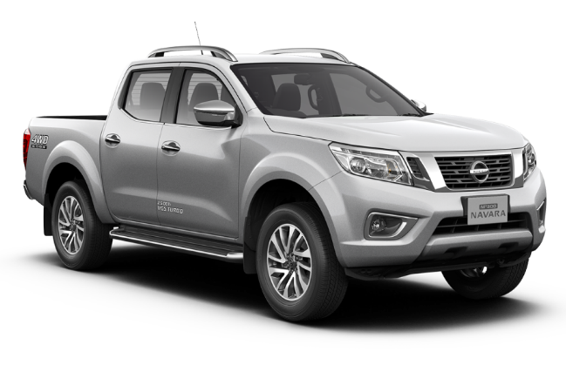
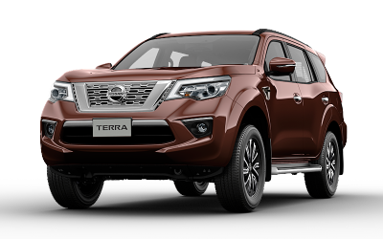
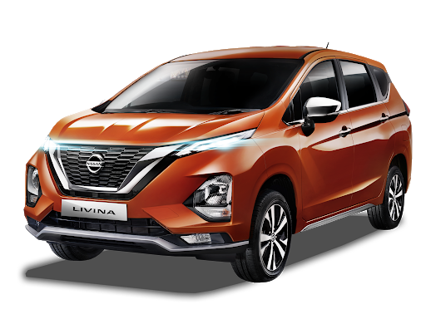
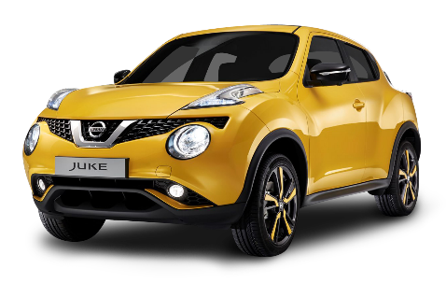
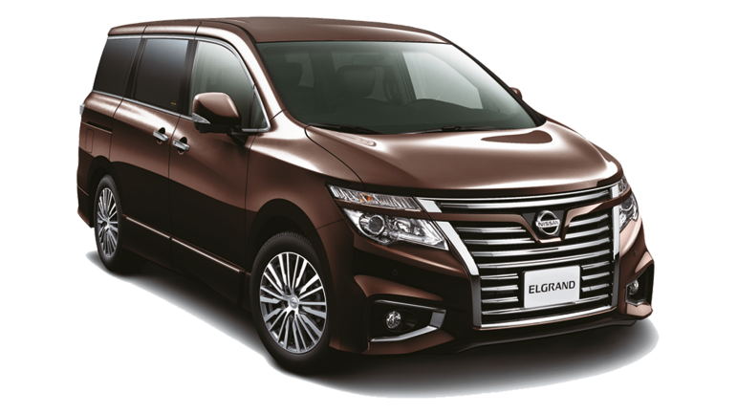
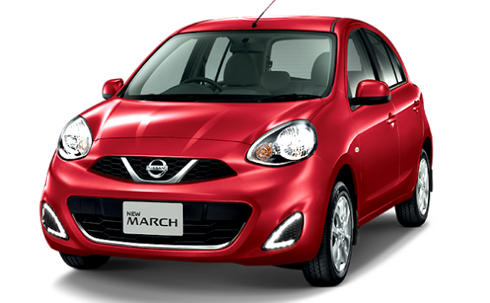
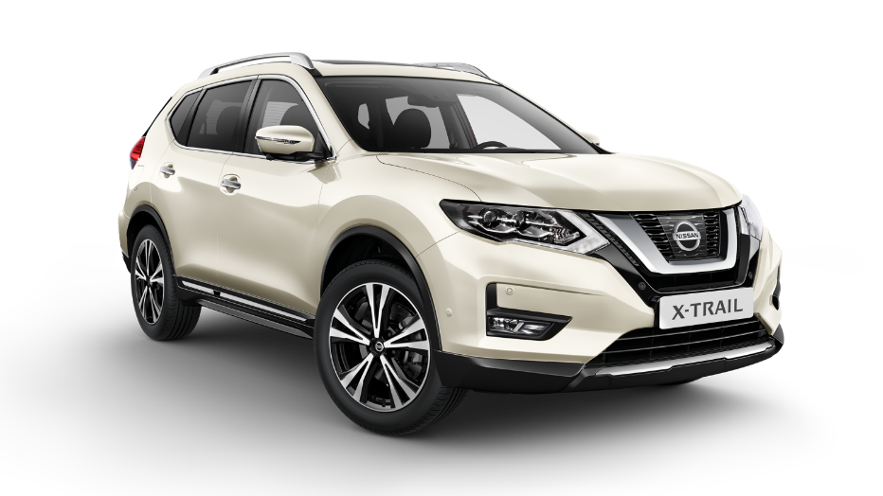
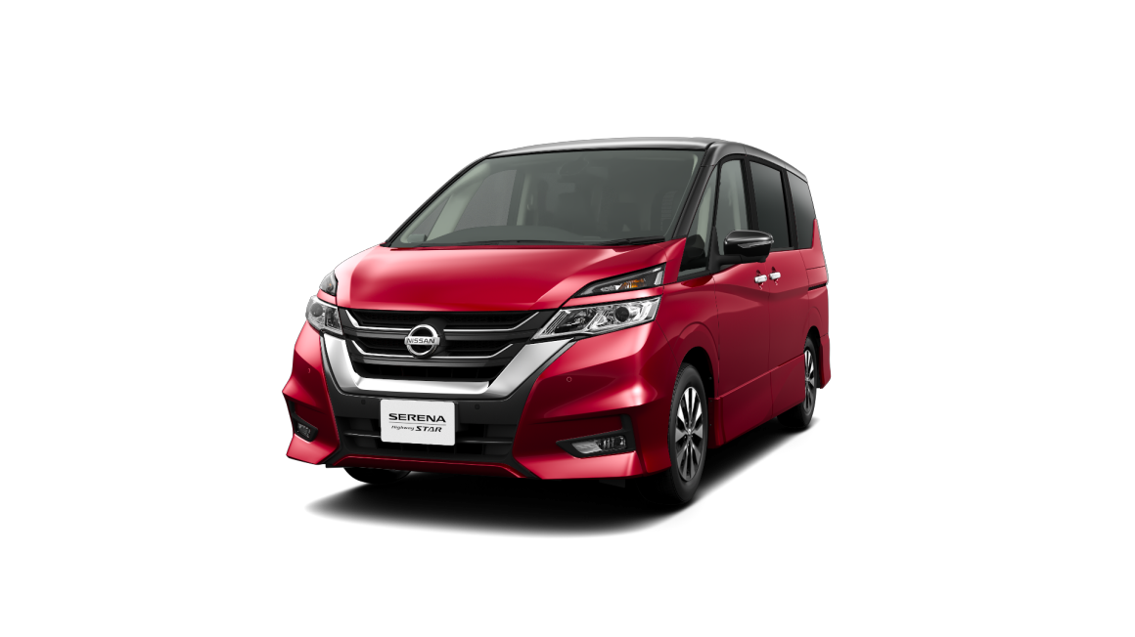
SSI Results

Slide 18


SSI Nissan Score & Compliance Trend – National (1/5)
Same as May period, according to Nissan car buyers, Nissan sales are not quite active because most of them did not offer test drives.
But Nissan car buyers feel young when looking at models on display.
Mean Score
GAP
Base
May’20
Base
Jun’20
Sales Initiation | Overall Satisfaction on Sales Initiation provided by salesperson |  | -0.03
 | Salesperson's explanation of features, advantages, and benefits of vehicle |  | 0.29
 | Overall satisfaction of test drive |  | 0.97
 | Thoroughness of Salesperson to follow up on your enquiries/requests |  | -0.14
Dealership Facility | Overall Satisfaction on Dealer Facility |  | 0.24
 | Comfort in showroom |  | -0.03
 | Ease of looking at models on display |  | 0.04
 | Accessibility of the dealership |  | 0.04
 | Quality of amenities |  | 0.28
33 | 113
33 | 112
20* | 76
33 | 113
22* | 100
22* | 100
22* | 100
22* | 100
22* | 98
Jun ‘20 (n=113)
May ‘20 (n=33)
*read with cautions for small base

Slide 19


SSI Nissan Score & Compliance Trend – National (2/5)
Same as May period, “Ease of coming to agreement on a final deal“ and “Timeliness of completing the final paperwork process“ are the 2 things that are felt to be
most convenient for buyers when they want to make a deal and take care of the paperwork of the vehicle
Mean Score
GAP
Base
May’20
Base
Jun’20
Deal | Overall rating of the deal |  | 0.04
 | Fairness of vehicle's price paid |  | 0.06
 | Ease of coming to agreement on a final deal |  | -0.08
 | Comfort of location negotiation |  | -0.04
Paperwork | Overall paperwork process |  | 0.00
 | Clarity of explaining documents |  | 0.00
 | Transparency of paperwork/finance process |  | 0.03
 | Timeliness of completing the final paperwork process |  | 0.04
32 | 113
33 | 113
33 | 113
29* | 111
33 | 113
33 | 113
33 | 113
33 | 113
Jun ‘20 (n=113)
May ‘20 (n=33)
*read with cautions for small base

Slide 20

SSI Nissan Score & Compliance Trend – National (3/5)
Nissan sales in the eyes of its users have served them courteously and friendly
Mean Score
GAP
Base
May’20
Base
Jun’20
Dealership Personel | Overall Dealership Personnel |  | -0.10
 | Knowledge about vehicles |  | 0.14
 | Serves efficiently and quickly |  | 0.01
 | Concern that you purchase the best vehicle for your needs |  | 0.19
 | Courtesy and friendliness |  | 0.04
 | Transparency of vehicles' price |  | 0.09
 | Use of technology throughout the sales process |  | -0.01
 | Effectiveness of non-face-to-face communication |  | 0.01
33 | 113
33 | 113
33 | 113
33 | 112
33 | 113
33 | 113
32 | 112
33 | 111
Jun ‘20 (n=113)
May ‘20 (n=33)
*read with cautions for small base

Slide 21

SSI Nissan Score & Compliance Trend – National (4/5)
The plus point of Nissan's delivery process is the time of delivery the vehicle on June period.
Mean Score
GAP
Base
May’20
Base
Jun’20
Delivery Process | Overall rating of the delivery process |  | 0.07
 | Condition of your vehicle |  | -0.09
 | Effectiveness in explaining your vehicle’s features |  | 0.21
 | Timeliness of completing the final delivery |  | 0.17
 | Overall rating of the delivery timing |  | -0.05
 | Length of time needed to deliver your vehicle |  | 0.06
 | Appropriateness of updates regarding your vehicle delivery status |  | 0.01
 | Ability to deliver vehicle at promised date/ time |  | 0.03
33 | 113
33 | 113
33 | 112
31 | 112
33 | 113
33 | 113
33 | 113
33 | 113
Jun ‘20 (n=113)
May ‘20 (n=33)
*read with cautions for small base

Slide 22

SSI Nissan Score & Compliance Trend – National (5/5)
Nissan users are not quite satisfied with the service provided because their interior and exterior are not clean and damaged at delivery
Mean Score
GAP
Base
May’20
Base
Jun’20
Follow Up | Overall rating of the delivery process |  | -0.03
33 | 113
Compliance | Delivery Process | Interior and exterior clean and undamaged at delivery
 |  | Sales person explained the reason of lateness in delivery process
 |  | Salesperson delivered the vehicle
 |  | Delivered with special ceremony : Photo session
 |  | Thanked for purchase at delivery
 |  | Introduced to service personnel in service department
 |  | Contacted after delivery
33 | 113
3* | 2*
33 | 113
33 | 113
33 | 113
33 | 113
33 | 113
Jun ‘20 (n=113)
May ‘20 (n=33)
*read with cautions for small base

Slide 23

Follow-up after Vehicle Delivery – SSI Nissan
How long have you been
followed-up after the delivery?
n = 103

Slide 24
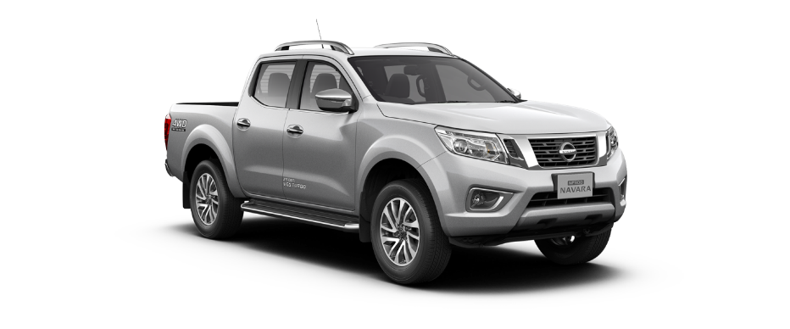
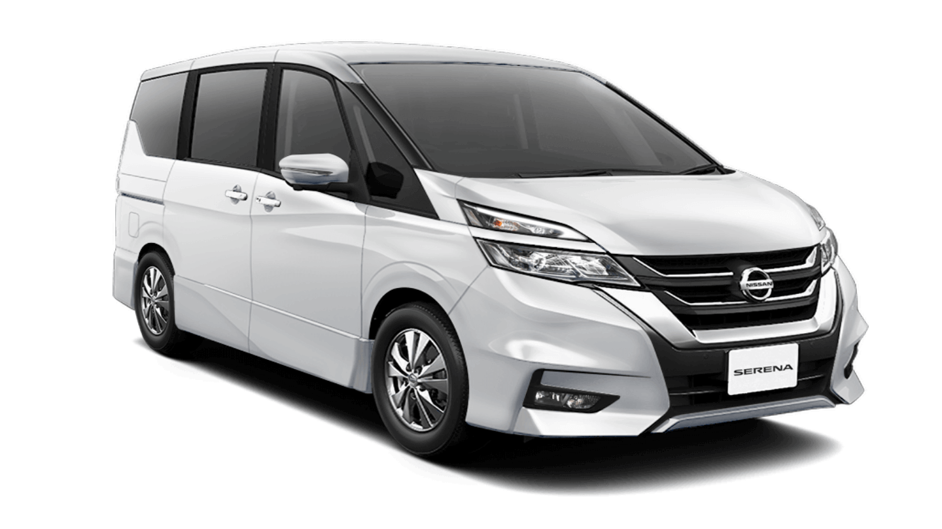
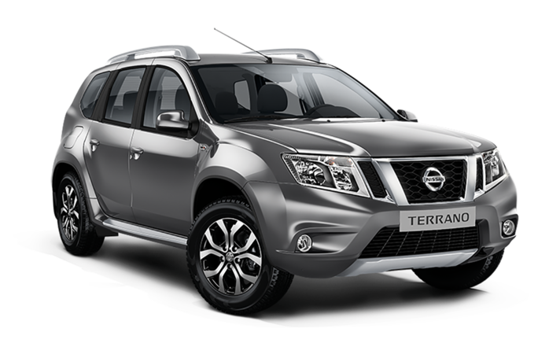
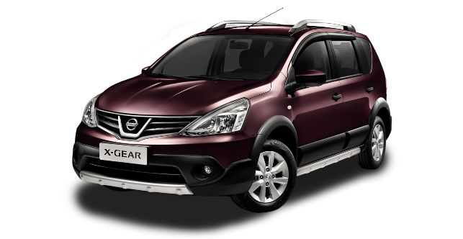

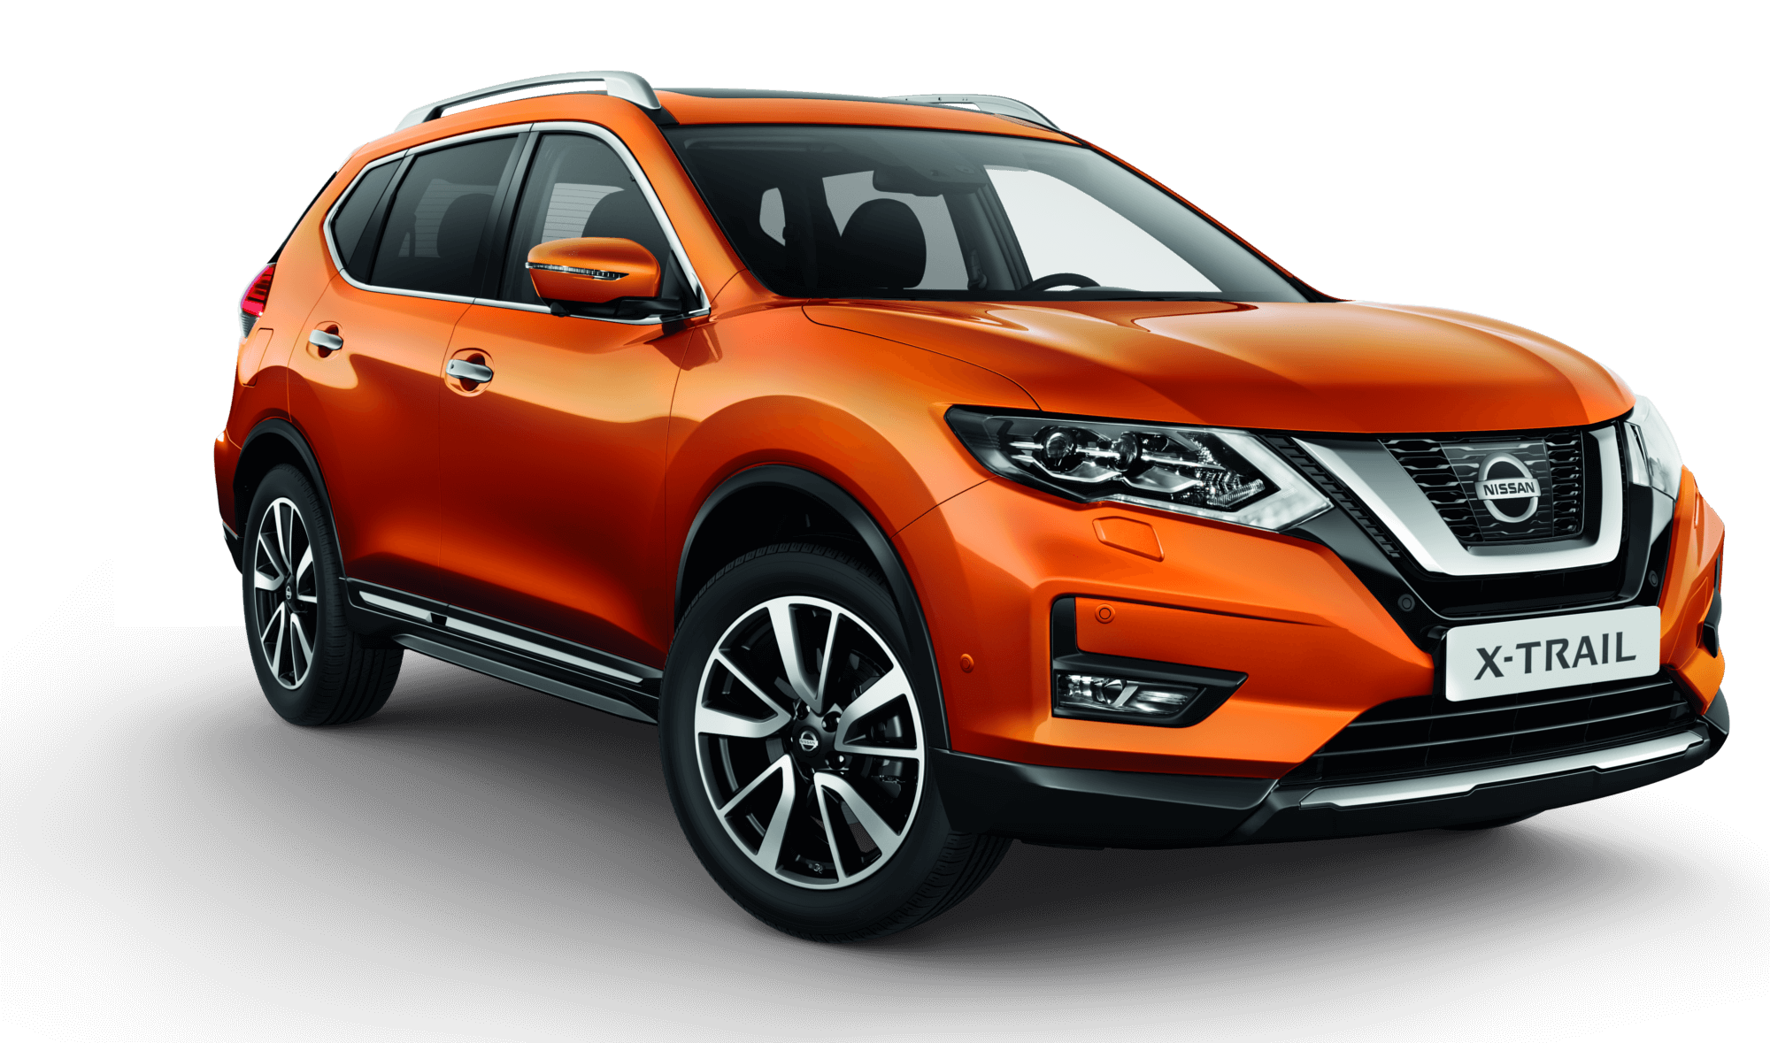

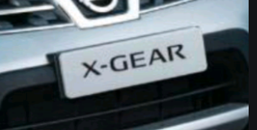

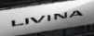
CSI Results

Slide 25

CSI Nissan Datsun Score & Compliance Trend – National (1/4)
All the service initiation things need to be improved by Nissan in next period, because Mean Score of each thing are decrease in June period
Mean Score
GAP
Base
May’20
Base
Jun’20
Service Initiation | Satisfaction with service initiation provided by Sales Advisor |  | -0.12
 | Ease of arranging service visit |  | -0.08
 | Flexibility to accommodate schedule |  | -0.09
 | Timeliness of hand over process |  | -0.15
 | Convenient business days/ hours of operation |  | -0.09
850 | 1,668
765 | 1,466
751 | 1,454
851 | 1,664
852 | 1,663
Jun ‘20 (n=1,668)
May ‘20 (n=853)
*read with cautions for small base

Slide 26

CSI Nissan Datsun Score & Compliance Trend – National (2/4)
All the service advisor things need to be improved by Nissan in next period, because Mean Score of each thing are decrease in June period.
Mean Score
GAP
Base
May’20
Base
Jun’20
Service Advisor | Satisfaction with service advisor |  | -0.09
 | Courtesy of Service Advisor |  | -0.06
 | Responsiveness of Service Advisor |  | -0.08
 | Thoroughness of Service Advisor explanations |  | -0.10
 | Repeated requests to ensure all understood |  | -0.10
 | Kept you informed of vehicle status |  | -0.10
 | Explanation of work after service completed |  | -0.09
 | Reviewed work done on vehicle |  | -0.12
 | Performed an inspection of vehicle |  | -0.11
853 | 1,668
853 | 1,668
853 | 1,666
853 | 1,667
849 | 1,652
844 | 1,648
852 | 1,664
851 | 1,654
844 | 1,631
Jun ‘20 (n=1,668)
May ‘20 (n=853)
*read with cautions for small base

Slide 27


CSI Nissan Datsun Score & Compliance Trend – National (3/4)
Same as May period, Nissan users feel that the fairness of the charge is still one of the factors that makes Nissan's customer satisfaction down.
Mean Score
GAP
Base
May’20
Base
Jun’20
Service Facility | Satisfaction on service facility |  | -0.04
 | Ease of driving in/out of facility |  | -0.08
 | Convenience of parking location |  | -0.05
 | Cleanliness of dealership |  | -0.08
 | Comfort of waiting area |  | -0.08
Vehicle Pickup | Satisfaction with vehicle pick-up process from Dealer |  | -0.13
 | Timeliness of the pick-up process |  | -0.12
 | Fairness of the charges |  | -0.08
 | Helpfulness of staff at pick-up |  | -0.06
852 | 1,666
851 | 1,657
850 | 1,661
853 | 1,668
836 | 1,636
853 | 1,665
853 | 1,666
806 | 1,590
851 | 1,663
Jun ‘20 (n=1,668)
May ‘20 (n=853)
*read with cautions for small base

Slide 28

CSI Nissan Datsun Score & Compliance Trend – National (4/4)
Same as May period, according to Nissan users, the vehicle was not washed and vacuumed when it was finished servicing.
Mean Score
GAP
Base
May’20
Base
Jun’20
Service Quality | Satisfaction with the quality of work performed on your vehicle |  | -0.16
 | Total time required to service your vehicle |  | -0.18
 | Thoroughness of maintenance/repair work performed |  | -0.14
 | Condition/cleanliness of vehicle on return |  | -0.11
Follow Up | Rating of dealer to follow you up regarding your vehicle services after delivery |  | -0.13
853 | 1,668
852 | 1,667
852 | 1,666
848 | 1,665
675 | 1,239
Compliance | Service Advisor | Service Advisor tell the reason of delay in service time
 | Delivery Process | Work done right first time
 |  | Contacted after service
 |  | Vehicle washed and vacuumed after service
41 | 131
853 | 1,668
853 | 1,668
853 | 1,668
Jun ‘20 (n=1,668)
May ‘20 (n=853)
*read with cautions for small base

Slide 29
Follow-up after Vehicle Delivery – CSI Nissan Datsun
How long have you been
contacted after the service done?
n = 1,006

Slide 30
DEALER RANKING

Slide 31
Rank Area Dealer by Dealer (National) (1/5)
Type 3S – S.i.S (1/4)
Dealer Name | SSI Nissan | CSI Nissan-Datsun | DPM | DPM Achievement | DPM (Last Month) | DPM Achievement (Last month) | Rank | Rank (Last month) | Rank (+/- last month)
NISSAN BANTUL | 1,000 | 952 | 976 | 107.85% | 954 | 105.42% | 1 | 9 | 8
NISSAN ROXY | 1,000 | 946 | 973 | 107.52% | 948 | 104.71% | 2 | 12 | 10
NISSAN JEMUR SARI | 972 | 960 | 966 | 106.73% | 921 | 101.74% | 3 | 26 | 23
NISSAN WARUNG BUNCIT | 1,000 | 918 | 959 | 105.99% | 896 | 98.97% | 4 | 35 | 31
NISSAN NUSA DUA | 1,000 | 917 | 959 | 105.92% | 923 | 102.04% | 5 | 23 | 18
NISSAN SOEKARNO HATTA | 987 | 923 | 955 | 105.51% | 928 | 102.55% | 6 | 17 | 11
NISSAN CIKUPA | 996 | 911 | 953 | 105.35% | 924 | 102.09% | 7 | 22 | 15
NISSAN TEGAL | 998 | 902 | 950 | 105.01% | 922 | 101.89% | 8 | 25 | 17
NISSAN KUNINGAN | 0 | 949 | 949 | 104.82% | 943 | 104.19% | 9 | 14 | 5
NISSAN SM RAJA | 966 | 928 | 947 | 104.65% | 976 | 107.88% | 10 | 4 | -6
NISSAN KEDAWUNG | 998 | 888 | 943 | 104.22% | 854 | 94.36% | 11 | 54 | 43
NISSAN ACEH | 0 | 943 | 943 | 104.15% | 960 | 106.09% | 12 | 8 | -4
NISSAN RANCAEKEK | 0 | 941 | 941 | 103.98% | 975 | 107.75% | 13 | 5 | -8
NISSAN CIBUBUR | 998 | 877 | 937 | 103.57% | 916 | 101.18% | 14 | 28 | 14
NISSAN KENDARI | 0 | 933 | 933 | 103.14% | 914 | 101.01% | 15 | 29 | 14
NISSAN SUKAMAJU | 991 | 875 | 933 | 103.09% | 940 | 103.89% | 16 | 15 | -1
NISSAN GATOT SUBROTO BALI | 995 | 870 | 932 | 103.00% | 871 | 96.20% | 17 | 48 | 31
NISSAN SOLO BARU | 1,000 | 864 | 932 | 102.98% | 862 | 95.24% | 18 | 53 | 35
NISSAN LABUHAN RATU | 983 | 877 | 930 | 102.75% | 0 | 0.00% | 19 | 93 | 74
NISSAN PETTARANI | 979 | 875 | 927 | 102.40% | 822 | 90.87% | 20 | 61 | 41
NISSAN INDRAMAYU | 0 | 927 | 927 | 102.40% | 899 | 99.35% | 21 | 33 | 12
NISSAN KARAWANG | 979 | 871 | 925 | 102.25% | 0 | 0.00% | 22 | 79 | 57
NISSAN VETERAN | 959 | 888 | 924 | 102.08% | 867 | 95.75% | 23 | 51 | 28
NISSAN PANGKAL PINANG | 994 | 852 | 923 | 102.01% | 839 | 92.66% | 24 | 56 | 32
NISSAN AHMAD YANI SURABAYA | 942 | 902 | 922 | 101.92% | 891 | 98.42% | 25 | 37 | 12

Slide 32
Rank Area Dealer by Dealer (National) (2/5)
Type 3S – S.i.S (2/4)
Dealer Name | SSI Nissan | CSI Nissan-Datsun | DPM | DPM Achievement | DPM (Last Month) | DPM Achievement (Last month) | Rank | Rank (Last month) | Rank (+/- last month)
NISSAN RADIN INTEN | 972 | 870 | 921 | 101.76% | 0 | 0.00% | 26 | 73 | 47
NISSAN ALAM SUTERA | 975 | 864 | 919 | 101.56% | 822 | 90.82% | 27 | 62 | 35
NISSAN BUMI SERPONG DAMAI | 0 | 916 | 916 | 101.24% | 883 | 97.61% | 28 | 39 | 11
NISSAN PARUNG | 965 | 866 | 916 | 101.18% | 910 | 100.58% | 29 | 30 | 1
NISSAN MLATI | 1,000 | 830 | 915 | 101.11% | 951 | 105.10% | 30 | 11 | -19
NISSAN GIANYAR | 0 | 914 | 914 | 101.04% | 805 | 89.00% | 31 | 64 | 33
NISSAN YASMIN | 952 | 874 | 913 | 100.88% | 888 | 98.16% | 32 | 38 | 6
NISSAN SM AMIN | 951 | 865 | 908 | 100.37% | 823 | 90.95% | 33 | 60 | 27
NISSAN PLUIT | 0 | 908 | 908 | 100.36% | 0 | 0.00% | 34 | 72 | 38
NISSAN SERANG PUSAT | 0 | 907 | 907 | 100.22% | 0 | 0.00% | 35 | 78 | 43
NISSAN TOMANG | 976 | 832 | 904 | 99.86% | 897 | 99.17% | 36 | 34 | -2
NISSAN BATAM | 0 | 903 | 903 | 99.74% | 927 | 102.43% | 37 | 20 | -17
NISSAN SUKABUMI | 0 | 903 | 903 | 99.73% | 974 | 107.64% | 38 | 6 | -32
NISSAN PROBOLINGGO | 0 | 898 | 898 | 99.18% | 881 | 97.31% | 39 | 40 | 1
NISSAN MAGELANG | 864 | 931 | 897 | 99.17% | 951 | 105.13% | 40 | 10 | -30
NISSAN CINERE | 0 | 892 | 892 | 98.58% | 0 | 0.00% | 41 | 75 | 34
NISSAN BEKASI BARAT | 919 | 865 | 892 | 98.57% | 965 | 106.58% | 42 | 7 | -35
NISSAN PEKALONGAN | 0 | 888 | 888 | 98.16% | 0 | 0.00% | 43 | 83 | 40
NISSAN BANYUWANGI | 0 | 888 | 888 | 98.07% | 879 | 97.15% | 44 | 41 | -3
NISSAN PURI INDAH | 928 | 845 | 886 | 97.95% | 835 | 92.30% | 45 | 58 | 13
NISSAN PULOGADUNG | 918 | 851 | 884 | 97.73% | 0 | 0.00% | 46 | 74 | 28
NISSAN BINTARO | 906 | 862 | 884 | 97.66% | 999 | 110.34% | 47 | 1 | -46
NISSAN CIKARANG | 923 | 834 | 878 | 97.03% | 864 | 95.48% | 48 | 52 | 4
NISSAN CIMAHI | 0 | 878 | 878 | 97.01% | 0 | 0.00% | 49 | 80 | 31
NISSAN AHMAD YANI BANJARMASIN | 899 | 856 | 878 | 96.98% | 997 | 110.16% | 50 | 3 | -47

Slide 33
Rank Area Dealer by Dealer (National) (3/5)
Type 3S – S.i.S (3/4)
Dealer Name | SSI Nissan | CSI Nissan-Datsun | DPM | DPM Achievement | DPM (Last Month) | DPM Achievement (Last month) | Rank | Rank (Last month) | Rank (+/- last month)
NISSAN PANTAI INDAH KAPUK | 0 | 873 | 873 | 96.44% | 869 | 96.06% | 51 | 49 | -2
NISSAN GUNUNG MALANG | 0 | 872 | 872 | 96.40% | 917 | 101.28% | 52 | 27 | -25
NISSAN SEMPAJA | 876 | 868 | 872 | 96.37% | 837 | 92.49% | 53 | 57 | 4
NISSAN SETIABUDI | 880 | 863 | 871 | 96.29% | 869 | 96.05% | 54 | 50 | -4
NISSAN GADING SERPONG | 873 | 865 | 869 | 96.01% | 0 | 0.00% | 55 | 68 | 13
NISSAN SANDUBAYA | 0 | 868 | 868 | 95.91% | 895 | 98.94% | 56 | 36 | -20
NISSAN MADIUN | 0 | 867 | 867 | 95.82% | 928 | 102.51% | 57 | 18 | -39
NISSAN KHATIB SULAIMAN | 847 | 885 | 866 | 95.71% | 0 | 0.00% | 58 | 90 | 32
NISSAN TB SIMATUPANG | 918 | 813 | 865 | 95.61% | 871 | 96.28% | 59 | 46 | -13
NISSAN DURI | 0 | 858 | 858 | 94.84% | 872 | 96.40% | 60 | 45 | -15
NISSAN SERANG BARAT | 816 | 898 | 857 | 94.72% | 0 | 0.00% | 61 | 77 | 16
NISSAN PURWOKERTO | 0 | 856 | 856 | 94.64% | 871 | 96.28% | 62 | 47 | -15
NISSAN KEDIRI | 0 | 855 | 855 | 94.46% | 790 | 87.28% | 63 | 66 | 3
NISSAN SIDOARJO | 881 | 825 | 853 | 94.22% | 0 | 0.00% | 64 | 87 | 23
NISSAN GORONTALO | 0 | 852 | 852 | 94.12% | 874 | 96.57% | 65 | 44 | -21
NISSAN JATI | 0 | 846 | 846 | 93.44% | 907 | 100.26% | 66 | 31 | -35
NISSAN SOEKARNO HATTA PLG | 812 | 870 | 841 | 92.94% | 0 | 0.00% | 67 | 92 | 25
NISSAN BEKASI TIMUR | 0 | 840 | 840 | 92.83% | 770 | 85.06% | 68 | 67 | -1
NISSAN ISTANA | 0 | 838 | 838 | 92.65% | 922 | 101.90% | 69 | 24 | -45
NISSAN RTA. MILONO (PALANGKARAYA) | 0 | 836 | 836 | 92.39% | 0 | 0.00% | 70 | 88 | 18
NISSAN KELAPA GADING | 0 | 835 | 835 | 92.31% | 904 | 99.91% | 71 | 32 | -39
NISSAN SUNTER | 0 | 833 | 833 | 92.09% | 926 | 102.27% | 72 | 21 | -51
NISSAN PALU | 0 | 832 | 832 | 91.91% | 945 | 104.47% | 73 | 13 | -60
NISSAN GATOT SUBROTO MEDAN | 0 | 831 | 831 | 91.82% | 937 | 103.55% | 74 | 16 | -58
NISSAN PURI ANJASMORO | 0 | 831 | 831 | 91.81% | 0 | 0.00% | 75 | 85 | 10

Slide 34
Rank Area Dealer by Dealer (National) (4/5)
Type 3S – S.i.S (4/4)
Dealer Name | SSI Nissan | CSI Nissan-Datsun | DPM | DPM Achievement | DPM (Last Month) | DPM Achievement (Last month) | Rank | Rank (Last month) | Rank (+/- last month)
NISSAN A.YANI PONTIANAK | 810 | 849 | 829 | 91.63% | 790 | 87.28% | 76 | 65 | -11
NISSAN MARTADINATA | 0 | 827 | 827 | 91.36% | 928 | 102.49% | 77 | 19 | -58
NISSAN JEBRES | 816 | 835 | 825 | 91.19% | 998 | 110.33% | 78 | 2 | -76
NISSAN PURWAKARTA | 0 | 823 | 823 | 90.98% | 876 | 96.81% | 79 | 42 | -37
NISSAN JEMBER | 0 | 823 | 823 | 90.97% | 810 | 89.46% | 80 | 63 | -17
NISSAN SALATIGA | 0 | 822 | 822 | 90.84% | 0 | 0.00% | 81 | 82 | 1
NISSAN KUPANG | 800 | 812 | 806 | 89.06% | 848 | 93.67% | 82 | 55 | -27
NISSAN JUANDA | 0 | 803 | 803 | 88.72% | 0 | 0.00% | 83 | 81 | -2
NISSAN PONDOK INDAH | 0 | 799 | 799 | 88.25% | 0 | 0.00% | 84 | 76 | -8
NISSAN BASUKI RAHMAT | 0 | 796 | 796 | 87.96% | 0 | 0.00% | 85 | 86 | 1
NISSAN JATAKE | 0 | 794 | 794 | 87.77% | 825 | 91.19% | 86 | 59 | -27
NISSAN SILIWANGI | 0 | 782 | 782 | 86.45% | 0 | 0.00% | 87 | 69 | -18
NISSAN HARAPAN INDAH | 0 | 765 | 765 | 84.58% | 875 | 96.68% | 88 | 43 | -45
NISSAN DEPOK | 0 | 727 | 727 | 80.34% | 0 | 0.00% | 89 | 70 | -19
NISSAN ARENGKA | 0 | 657 | 657 | 72.57% | 0 | 0.00% | 90 | 89 | -1
NISSAN DAAN MOGOT | 0 | 0 | 0 | 0.00% | 0 | 0.00% | 91 | 71 | -20
NISSAN MAJAPAHIT | 0 | 0 | 0 | 0.00% | 0 | 0.00% | 92 | 84 | -8
NISSAN P. HIDAYAT | 0 | 0 | 0 | 0.00% | 0 | 0.00% | 93 | 91 | -2

Slide 35
Rank Area Dealer by Dealer (National) (5/5)
Type 3S – NE
Dealer Name | SSI Nissan | CSI Nissan-Datsun | DPM | DPM Achievement | DPM (Last Month) | DPM Achievement (Last month) | Rank | Rank (Last month) | Rank (+/- last month)
NISSAN AMIR HAMZAH | 1,000 | 896 | 948 | 104.74% | 968 | 106.91% | 1 | 1 | 0
NISSAN S. PARMAN | 991 | 863 | 927 | 102.39% | 860 | 95.02% | 2 | 3 | 1
NISSAN CITRALAND SURABAYA | 0 | 904 | 904 | 99.89% | 923 | 102.02% | 3 | 2 | -1
NISSAN LATIMOJONG | 0 | 853 | 853 | 94.24% | 820 | 90.58% | 4 | 4 | 0
Type 3S – DE
Dealer Name | SSI Nissan | CSI Nissan-Datsun | DPM | DPM Achievement | DPM (Last Month) | DPM Achievement (Last month) | Rank | Rank (Last month) | Rank (+/- last month)
DATSUN ADAM MALIK | 0 | 846 | 846 | 93.44% | 979 | 108.18% | 1 | 1 | 0
DATSUN S.PARMAN | 0 | 0 | 0 | 0.00% | 0 | 0.00% | 2 | 2 | 0
Type 3S – S.i.S
Dealer Name | SSI Nissan | CSI Nissan-Datsun | DPM | DPM Achievement | DPM (Last Month) | DPM Achievement (Last month) | Rank | Rank (Last month) | Rank (+/- last month)
NISSAN MT. HARYONO | 968 | 0 | 968 | 106.97% | 926 | 102.35% | 1 | 1 | 0
NISSAN MOJOKERTO | 0 | 0 | 0 | 0.00% | 0 | 0.00% | 2 | 2 | 0
NISSAN TEGALREJO | 0 | 0 | 0 | 0.00% | 0 | 0.00% | 3 | 3 | 0
Type 2S
Dealer Name | SSI Nissan | CSI Nissan-Datsun | DPM | DPM Achievement | DPM (Last Month) | DPM Achievement (Last month) | Rank | Rank (Last month) | Rank (+/- last month)
NISSAN HALIM | 0 | 916 | 916 | 101.22% | 922 | 101.85% | 1 | 1 | 0
NISSAN KOMBOS | 0 | 0 | 0 | 0.00% | 0 | 0.00% | 2 | 2 | 0

Slide 36
Customer Service Area Ranking – May 2020 (1/2)
CSA | Dealer Name | SSI Nissan | CSI Nissan-Datsun | DPM | DPM Achievement | DPM (Last Month) | DPM Achievement (Last month) | Rank | Rank (Last month) | Rank (+/- last month)
CSA #22 | IMG | 998 | 899 | 949 | 104.82% | 887 | 97.96% | 1 | 24 | 23
CSA #42B | MPA | 966 | 928 | 947 | 104.65% | 976 | 107.88% | 2 | 2 | 0
CSA #19 | IMG | 980 | 910 | 945 | 104.40% | 912 | 100.74% | 3 | 17 | 14
CSA #41 | IMG | 0 | 943 | 943 | 104.15% | 960 | 106.09% | 4 | 6 | 2
CSA #42 | IMG | 1,000 | 884 | 942 | 104.11% | 970 | 107.16% | 5 | 4 | -1
CSA #20 | MPA | 0 | 941 | 941 | 103.98% | 975 | 107.75% | 6 | 3 | -3
CSA #33 | IMG | 996 | 885 | 941 | 103.92% | 883 | 97.59% | 7 | 26 | 19
CSA #29 | SB/Yogyakarta | 952 | 919 | 935 | 103.37% | 904 | 99.91% | 8 | 19 | 11
CSA #11 | JKM | 983 | 887 | 935 | 103.31% | 866 | 95.65% | 9 | 32 | 23
CSA #3 | IMG | 998 | 868 | 933 | 103.06% | 916 | 101.18% | 10 | 15 | 5
CSA #47 | IMG | 983 | 877 | 930 | 102.75% | 0 | 0.00% | 11 | 44 | 33
CSA #5 | IMG | 991 | 867 | 929 | 102.66% | 940 | 103.89% | 12 | 8 | -4
CSA #39 | IMG | 979 | 879 | 929 | 102.65% | 864 | 95.43% | 13 | 34 | 21
CSA #24 | SB/Yogyakarta | 955 | 903 | 929 | 102.63% | 964 | 106.54% | 14 | 5 | -9
CSA #31 | IMG | 991 | 861 | 926 | 102.30% | 793 | 87.58% | 15 | 38 | 23
CSA #17 | IMG | 979 | 868 | 924 | 102.07% | 941 | 104.03% | 16 | 7 | -9
CSA #13 | AKA | 988 | 855 | 921 | 101.79% | 915 | 101.14% | 17 | 16 | -1
CSA #4 | IMG | 952 | 874 | 913 | 100.88% | 888 | 98.16% | 18 | 23 | 5
CSA #15 | IMG | 954 | 870 | 912 | 100.82% | 874 | 96.54% | 19 | 27 | 8
CSA #10 | IMG | 961 | 862 | 912 | 100.76% | 926 | 102.35% | 20 | 12 | -8
CSA #25 | IMG | 954 | 863 | 908 | 100.36% | 932 | 102.96% | 21 | 10 | -11
CSA #43 | IMG | 951 | 861 | 906 | 100.10% | 861 | 95.11% | 22 | 35 | 13
CSA #1 | IMG | 927 | 882 | 904 | 99.93% | 893 | 98.69% | 23 | 21 | -2
CSA #44 | RMM | 0 | 903 | 903 | 99.74% | 927 | 102.43% | 24 | 11 | -13
CSA #27 | SB/Yogyakarta | 0 | 895 | 895 | 98.90% | 923 | 102.02% | 25 | 13 | -12

Slide 37
Customer Service Area Ranking – May 2020 (2/2)
CSA | Dealer Name | SSI Nissan | CSI Nissan-Datsun | DPM | DPM Achievement | DPM (Last Month) | DPM Achievement (Last month) | Rank | Rank (Last month) | Rank (+/- last month)
CSA #8 | IMG | 928 | 859 | 893 | 98.71% | 841 | 92.93% | 26 | 36 | 10
CSA #12 | MPA | 919 | 855 | 887 | 98.01% | 889 | 98.18% | 27 | 22 | -5
CSA #6 | IMG | 923 | 834 | 878 | 97.03% | 864 | 95.48% | 28 | 33 | 5
CSA #18 | IMG | 0 | 878 | 878 | 97.01% | 0 | 0.00% | 29 | 41 | 12
CSA #37 | IMG | 899 | 856 | 878 | 96.98% | 997 | 110.16% | 30 | 1 | -29
CSA #38 | IMG | 876 | 870 | 873 | 96.48% | 873 | 96.48% | 31 | 28 | -3
CSA #32 | IMG | 0 | 873 | 873 | 96.42% | 866 | 95.74% | 32 | 31 | -1
CSA #23 | IMG | 880 | 860 | 870 | 96.12% | 869 | 96.05% | 33 | 30 | -3
CSA #45 | IMG | 847 | 885 | 866 | 95.71% | 0 | 0.00% | 34 | 43 | 9
CSA #16 | DPO | 816 | 906 | 861 | 95.15% | 0 | 0.00% | 35 | 40 | 5
CSA #46 | IMG | 873 | 848 | 860 | 95.06% | 920 | 101.63% | 36 | 14 | -22
CSA #30 | SB/Yogyakarta | 881 | 825 | 853 | 94.22% | 0 | 0.00% | 37 | 42 | 5
CSA #26 | IMG | 0 | 846 | 846 | 93.44% | 907 | 100.26% | 38 | 18 | -20
CSA #40 | IMG | 0 | 837 | 837 | 92.48% | 934 | 103.21% | 39 | 9 | -30
CSA #21 | IMG | 0 | 835 | 835 | 92.24% | 871 | 96.28% | 40 | 29 | -11
CSA #36 | IMG | 810 | 848 | 829 | 91.58% | 790 | 87.28% | 41 | 39 | -2
CSA #34 | IMG | 800 | 857 | 829 | 91.57% | 884 | 97.69% | 42 | 25 | -17
CSA #9 | IMG | 0 | 823 | 823 | 90.93% | 904 | 99.90% | 43 | 20 | -23
CSA #2 | IMG | 0 | 794 | 794 | 87.77% | 825 | 91.19% | 44 | 37 | -7

Slide 38
REGION INDEX SCORE

Slide 39
CSI & SSI Trend – SUMATERA (June 2020)
SSI NISSAN Index Score Result
CSI Index Score Result
Sample Size
12* | 5* | 11*
Sample Size
207 | 111 | 278
*read with cautions for small base

Slide 40
CSI & SSI Trend – JABODETABEK (June 2020)
SSI NISSAN Index Score Result
CSI Index Score Result
Sample Size
42 | 18* | 49
Sample Size
363 | 264 | 518
*read with cautions for small base

Slide 41
CSI & SSI Trend – WEST JAVA (June 2020)
SSI NISSAN Index Score Result
CSI Index Score Result
Sample Size
8* | 2* | 12*
Sample Size
140 | 75 | 129
*read with cautions for small base

Slide 42
CSI & SSI Trend – CENTRAL JAVA (June 2020)
SSI NISSAN Index Score Result
CSI Index Score Result
Sample Size
12* | 4* | 12*
Sample Size
200 | 110 | 213
*read with cautions for small base

Slide 43
CSI & SSI Trend – EAST JAVA (June 2020)
SSI NISSAN Index Score Result
CSI Index Score Result
Sample Size
14* | 2* | 15*
Sample Size
159 | 91 | 116
*read with cautions for small base

Slide 44
CSI & SSI Trend – BALI LOMBOK (June 2020)
SSI NISSAN Index Score Result
CSI Index Score Result
Sample Size
2* | 0* | 4*
Sample Size
79 | 62 | 105
*read with cautions for small base

Slide 45
CSI & SSI Trend – KALIMANTAN (June 2020)
SSI NISSAN Index Score Result
CSI Index Score Result
Sample Size
4* | 0* | 8*
Sample Size
73 | 40 | 130
*read with cautions for small base

Slide 46
CSI & SSI Trend – SULAWESI (June 2020)
SSI NISSAN Index Score Result
CSI Index Score Result
Sample Size
4* | 2* | 2*
Sample Size
94 | 100 | 179
*read with cautions for small base

Slide 47
DATABASE ACHIEVEMENT

Slide 48
SSI & CSI Achievement – Nissan Datsun
 | Sample Size Achievement |  | Sample Size Required |  | Total Sample Provided By Nissan |  | % Achievement
 | SSI Nissan | CSI | SSI Nissan | CSI | SSI Nissan | CSI | SSI Nissan | CSI
Apr 2020 | 98 | 1,315 | 1,040 | 3,640 | 216 | 4,343 | 45% | 36%
May 2020 | 33 | 853 | 1,040 | 3,640 | 57 | 2,163 | 58% | 23%
Jun 2020 | 113 | 1,668 | 1,040 | 3,640 | 299 | 6,060 | 38% | 46%
Jul 2020
Aug 2020
Sep 2020
Oct 2020
Nov 2020
Dec 2020
Jan 2021
Feb 2021
Mar 2021

Slide 49
SSI Nissan Achievement – May 2020
 | Number of Dealers | SSI Achievement | Sample Size Required | Sample Provided by Nissan | % Achievement | Total Interview | Failed Interview |  | % Invalid Data
 |  |  |  |  |  |  | Screening Process | Invalid Data
National | 48 | 113 | 1,040 | 299 | 38 | 276 | 109 | 54 | 20%
Sumatera | 7 | 11 | 150 | 40 | 28 | 40 | 18 | 11 | 28%
Jabodetabek | 19 | 49 | 340 | 148 | 33 | 129 | 52 | 28 | 22%
West Java | 4 | 12 | 110 | 27 | 44 | 25 | 11 | 2 | 8%
Central Java | 7 | 12 | 140 | 21 | 57 | 20 | 7 | 1 | 5%
East Java | 4 | 15 | 120 | 38 | 39 | 38 | 14 | 9 | 24%
Sulawesi | 1 | 2 | 80 | 6 | 33 | 5 | 3 | 0 | 0%
Bali Lombok | 3 | 4 | 50 | 4 | 100 | 4 | 0 | 0 | 0%
Kalimantan | 3 | 8 | 50 | 15 | 53 | 15 | 4 | 3 | 20%

Slide 50
CSI Nissan Datsun Achievement – May 2020
 | Number of Dealers | CSI Achievement | Sample Size Required | Sample Provided by Nissan | % Achievement | Total Interview | Failed Interview |  | % Invalid Data
 |  |  |  |  |  |  | Screening Process | Invalid Data
National | 96 | 1,668 | 3,640 | 6,060 | 28 | 5,720 | 3,285 | 767 | 13%
Sumatera | 14 | 278 | 525 | 968 | 29 | 905 | 486 | 141 | 16%
Jabodetabek | 32 | 518 | 1,190 | 1,824 | 28 | 1,725 | 1,014 | 193 | 11%
West Java | 11 | 129 | 385 | 464 | 28 | 432 | 249 | 54 | 13%
Central Java | 12 | 213 | 490 | 719 | 30 | 696 | 386 | 97 | 14%
East Java | 11 | 116 | 420 | 510 | 23 | 485 | 297 | 72 | 15%
Sulawesi | 6 | 179 | 280 | 643 | 28 | 603 | 345 | 79 | 13%
Bali Lombok | 5 | 105 | 175 | 402 | 26 | 385 | 227 | 53 | 14%
Kalimantan | 5 | 130 | 175 | 530 | 25 | 489 | 281 | 78 | 16%

Slide 51
Main Reason for Invalid Data of SSI Nissan
 | REASONS | % of NOT SUCCESS Apr 2020 | % of NOT SUCCESS May 2020 | % of NOT SUCCESS Jun 2020 | % of NOT SUCCESS Jul 2020 | % of NOT SUCCESS Aug 2020 | % of NOT SUCCESS Sep 2020 | % of NOT SUCCESS Oct 2020 | % of NOT SUCCESS Nov 2020 | % of NOT SUCCESS Dec 2020 | % of NOT SUCCESS Jan 2021 | % of NOT SUCCESS Feb 2021 | % of NOT SUCCESS Mar 2021
Personal Reason | Has different name with database | 5.56% | 3.51% | 3.99%
 | Have not received car from Nissan | 0.00% | 1.75% | 1.81%
 | Never visit the dealer | 0.00% | 0.00% | 0.36%
 | Cars have been sold to others | 0.00% | 0.00% | 0.00%
Technical Reason | Mailbox | 3.24% | 0.00% | 4.35%
 | Number are not active | 6.48% | 3.51% | 1.81%
 | No signal/ no dial tone | 0.46% | 0.00% | 0.36%
 | Phone number are diverted | 3.24% | 1.75% | 5.80%
 | Phone number are incomplete | 0.00% | 0.00% | 0.36%
 | Unlisted number | 0.00% | 0.00% | 1.81%
 | Could not be contacted | 3.24% | 0.00% | 3.62%
 | "Tulalit" tone | 0.00% | 0.00% | 0.00%
 | Phone number belonging to someone else (husband / wife / child / driver / etc) | 0.46% | 1.75% | 3.99%
 | Wrong number | 0.46% | 0.00% | 0.72%

Slide 52
Main Reason for Invalid Data of CSI Nissan
 | REASONS | % of NOT SUCCESS Apr 2020 | % of NOT SUCCESS May 2020 | % of NOT SUCCESS Jun 2020 | % of NOT SUCCESS Jul 2020 | % of NOT SUCCESS Aug 2020 | % of NOT SUCCESS Sep 2020 | % of NOT SUCCESS Oct 2020 | % of NOT SUCCESS Nov 2020 | % of NOT SUCCESS Dec 2020 | % of NOT SUCCESS Jan 2021 | % of NOT SUCCESS Feb 2021 | % of NOT SUCCESS Mar 2021
Personal Reason | Has different name with database | 0.81% | 2.17% | 2.41%
 | Cars have been sold to others | 1.31% | 0.42% | 0.89%
Technical Reason | Mailbox | 5.76% | 1.11% | 1.33%
 | Number are not active | 9.47% | 1.43% | 2.87%
 | No signal/ no dial tone | 1.20% | 0.05% | 1.21%
 | Phone number are diverted | 1.68% | 1.16% | 5.23%
 | Phone number are incomplete | 0.35% | 0.09% | 0.26%
 | Unlisted number | 3.50% | 0.74% | 1.80%
 | Could not be contacted | 1.52% | 2.45% | 7.13%
 | "Tulalit" tone | 0.14% | 0.00% | 0.05%
 | Phone number belonging to someone else (husband / wife / child / driver / etc) | 1.18% | 1.11% | 1.45%
 | Wrong number | 0.92% | 1.11% | 1.14%

Slide 53
Thank
You

